Slide 1
Building APIs Using Flask
Aditya Hriday Sahu

Slide 2
What are APIs?
The brains behind an interactive website/application
  Messengers of data and functionality
  Agents which make our projects alive and purposeful
Stand for “Application Programming Interfaces”
  “Application”: Any software with a distinct function
  “Interface”: Contract of service between two applications
APIs determine the ways of communication between two applications with the help of requests and responses
  Communication is necessary for making the applications interactive and purposeful!

Slide 3
Types of APIs
SOAP APIs
  XML data transfer
  Simple object access protocol
  Less flexible
RPC APIs
  Remote procedure calls
  Client completes a procedure on server followed by,
  Server sending an output back to the client
Websocket APIs
  JSON object data transfer
  Supports two-way communication between server and client
  More efficient than REST API
REST APIs
  Most popular and flexible APIs!
  Client sends requests to server → Server does internal functions → Server returns an output back to client

Slide 4
Why Flask? What are Endpoints?
You can not only make websites in Python using Flask but you can also create RESTful APIs using Flask
Flask is really known for developing microweb-services because it is a very light weighted module
For our purpose it is perfect, a lot less setup needs to be done for grtting started (very few lines of code!)
REST APIs can create/modify/fetch/delete data from structured data storage systems (Databases)
These REST APIs have a bunch of endpoints which can be thought of as commands/requests for accessing the database through the API followed by receiving an output from the sever

Slide 5
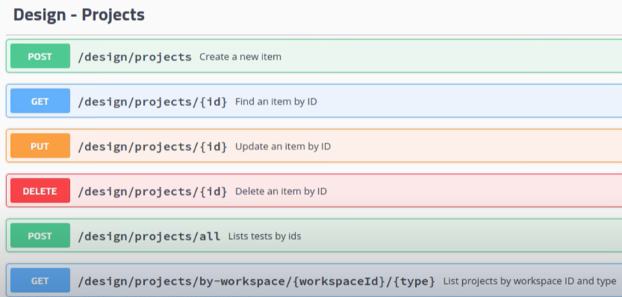
Requests and Endpoints

Slide 6

Getting Started – Initial Setup
Install pip/pip3 in your systems:
  Recommended that you use a Linux machine
    You can dualboot your system with a linux distro of your choice
    You can use a virtual machine to emulate linux like me
    You can enable WSL (Windows Subsystem for Linux) and use it
  If you have a Mac, it’s fine, you already have zsh
If not installed: ~$ sudo apt install python3-pip

Slide 7

Virtualenv Setup:
  Installation: sudo apt install python3-virtualenv
  Creating a new project directory with virtualenv
  ~$ virtualenv demo_proj
  ~$ source demo_proj/bin/activate
  ~$ cd demo_proj
  ~$ code .
  Rest of the code and setup is up on GitHub here:
  https://github.com/adityahridaysahu/flask-api-session

Slide 8
Thank You!

